Slide 1


Employees BURNOUT ANALYSIS and prediction

Slide 2

EMPLOYEES BURNOUT ANALYSIS AND PREDICTION
MY DETAILS:-
Name :- TOMPALA MOUNIKA
SkillsBuild Email id :- mounitompala052@gmail.com
College Name :- SRI SIVANI COLLEGE OF ENGINEERING
College State :- ANDHRA PRADESH
Internship Domain :- Artificial Intelligence
Internship Start and End date:- 05-06-2023 to 23-07-2023

Slide 3

Project topic :- Employees BURNOUT Analysis & prediction Using machine learning
Python comes with a huge number of inbuilt libraries.
Many of the libraries are for Artificial Intelligence, Machine Learning and Deep Learning.

Slide 4

AGENDA:-
Accurate prediction provides a number of important benefits for research and decision-making.
Occupational burnout is intertwined with individual, cultural, and social factors, the resolution of which requires methods that can deal with large amounts of data.
The application of such methods capable of dealing with large datasets is a relatively novel research area in social science.
For this purpose, this article presents insights into machine learning methods, mainly related to prediction tasks.

Slide 5
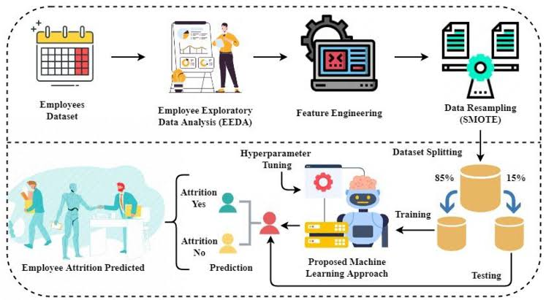
PROJECT Overview:-
Through machine learning techniques, new theoretical models of burnout can be created.
These algorithms can also provide new approaches to create data-driven interventions.
Burnout monitoring systems supported by machine-learning algorithms can also be used in recruitment processes and to supervise employees.

Slide 6
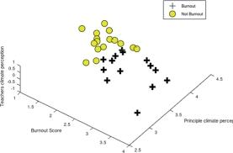
WHO ARE THE END USERS?
Machine learning is a vast field of knowledge and there is no single definition.
Machine learning is a part of data mining process, that also includes methods used to discover connections and patterns in large data sets.
Most models focus on two tasks: descriptive and predictive.
It’s rarely used in explanatory modeling because statistical models do it better.
To analyze the importance of the job-related factors in burnout, machine learning of generalized linear algorithms was performed.
These algorithms were fitted to estimate the set of parameters by maximizing the log-likelihood.

Slide 7
SOLUTION AND PRESENTATION
Machine learning methods to predict burnout and their practical implications.
Machine learning algorithms can lead to creating new theoretical models of burnout.
High-accuracy predictions can lead to discovering new, potential variables.
Machine learning model predictions allow businesses to make highly accurate guesses as to the likely outcomes of a question based on historical data, which can be about all kinds of things – customer churn likelihood, possible fraudulent activity, and more.

Slide 8

How did you customize the project and make it your own
Flexibility
Real-time notifications
Improved Security
Cost and time savings
Scalability
Learn from IBM Platform

Slide 9
MODELING
Import libraries
Add Dataset
Get General information
Extract all columns of dataset
Check the duplicate values
Calculate the mean,std,min,max,count of every attribute
Drop irrelevant column
Data Visualization
Count plot distribution of WHF
Count plot distribution of attributes with help of Histogram
Check correlation
Label encoding
Feature selection
Data splitting
Model implementation
Random forest regression

Slide 10
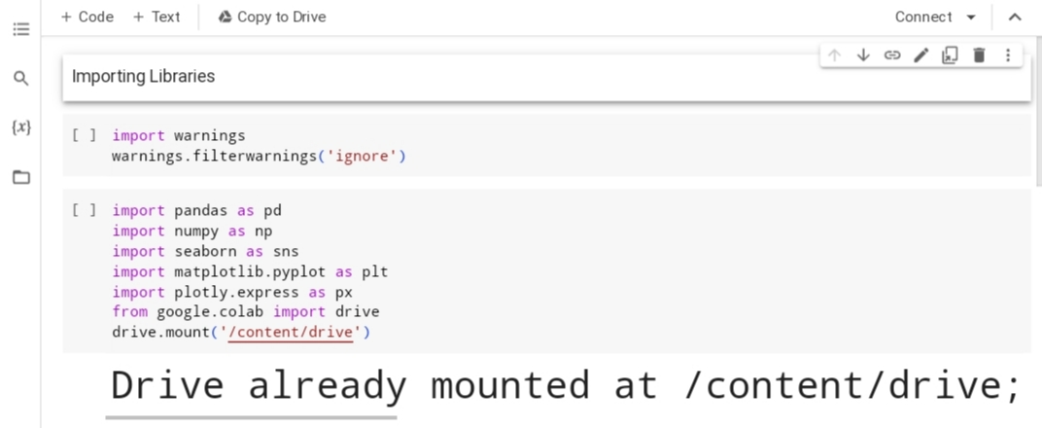
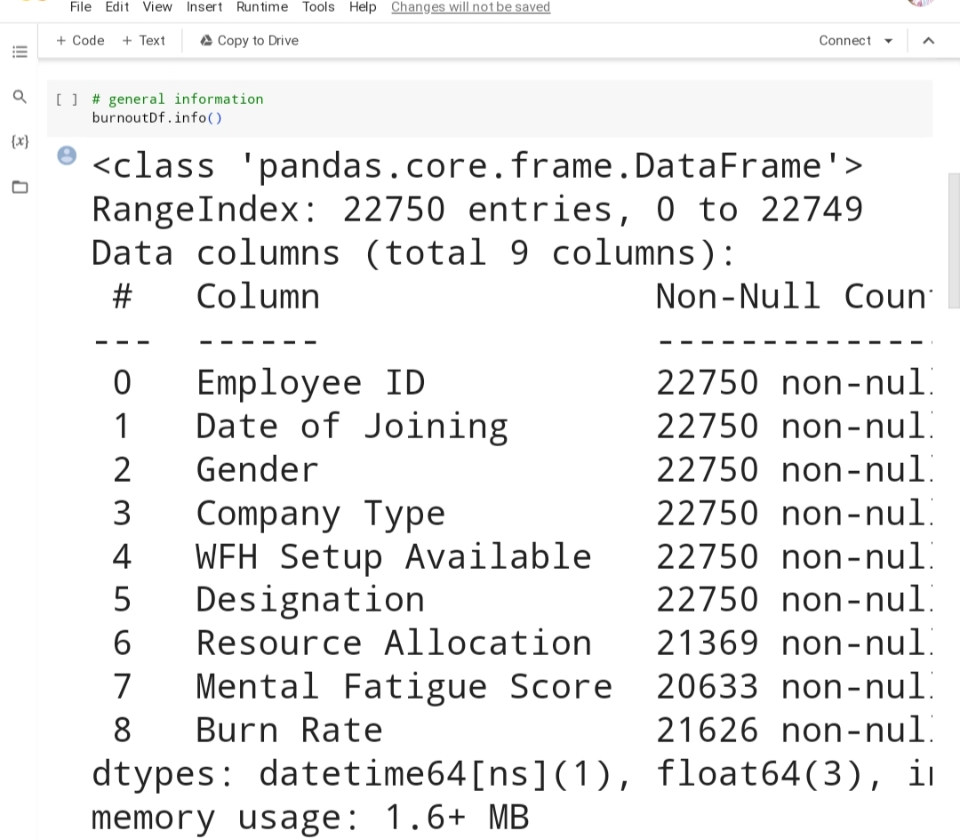

Slide 11
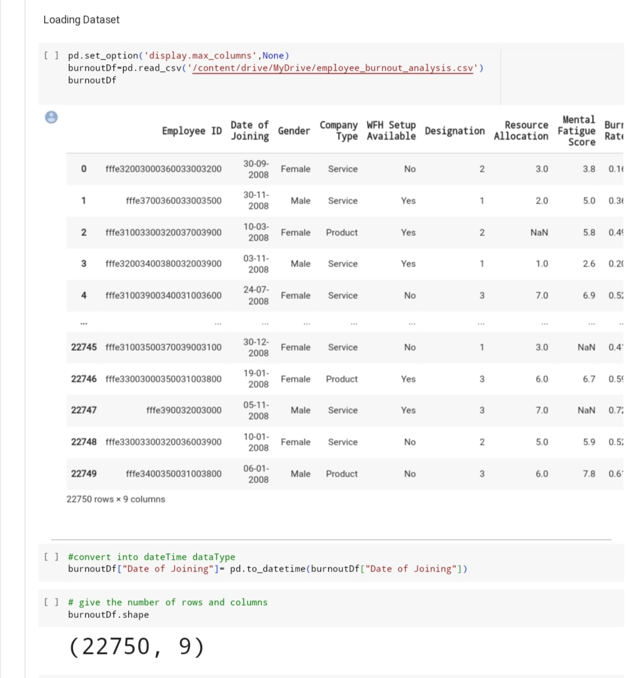

Slide 12
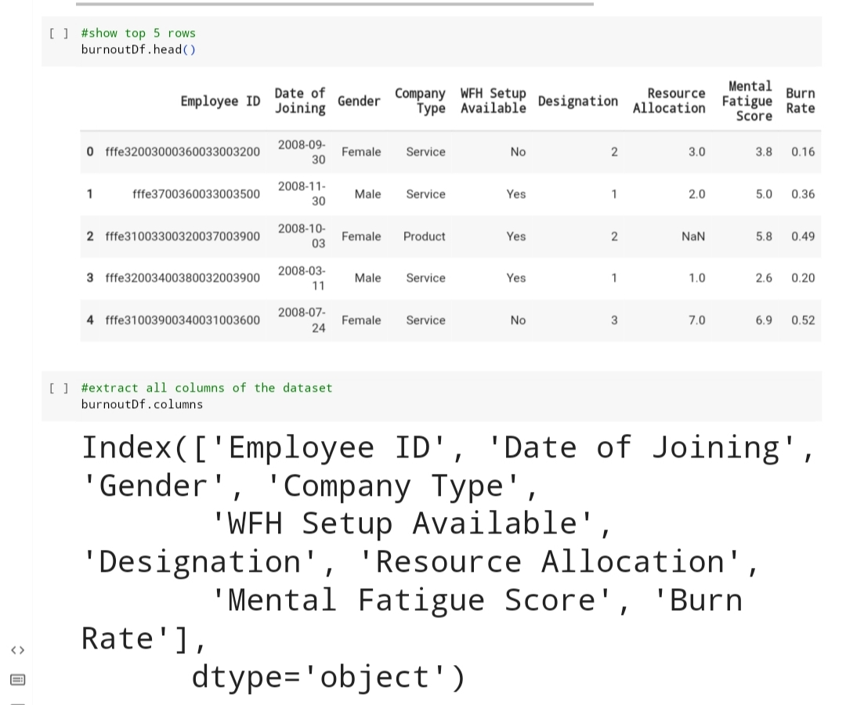
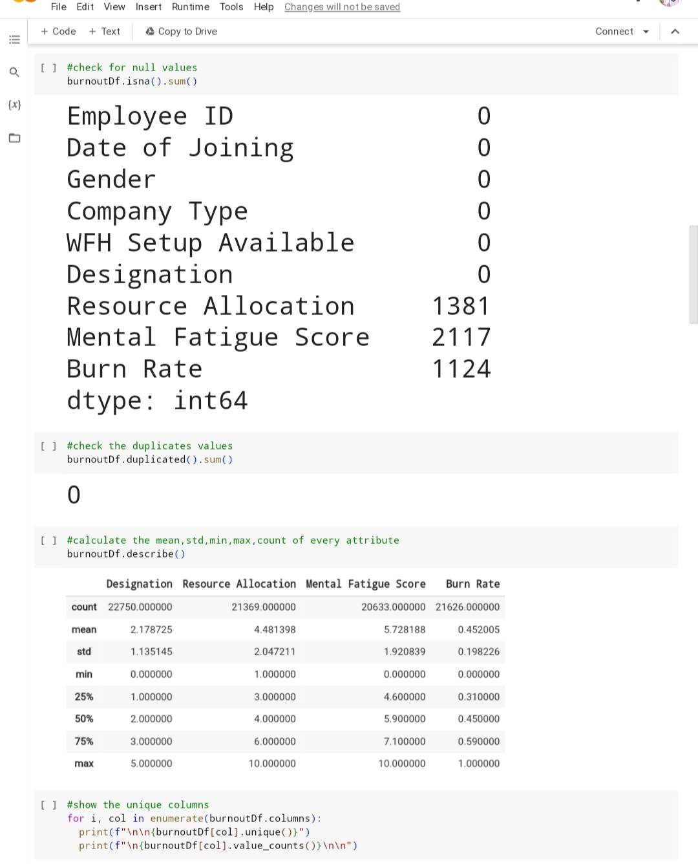
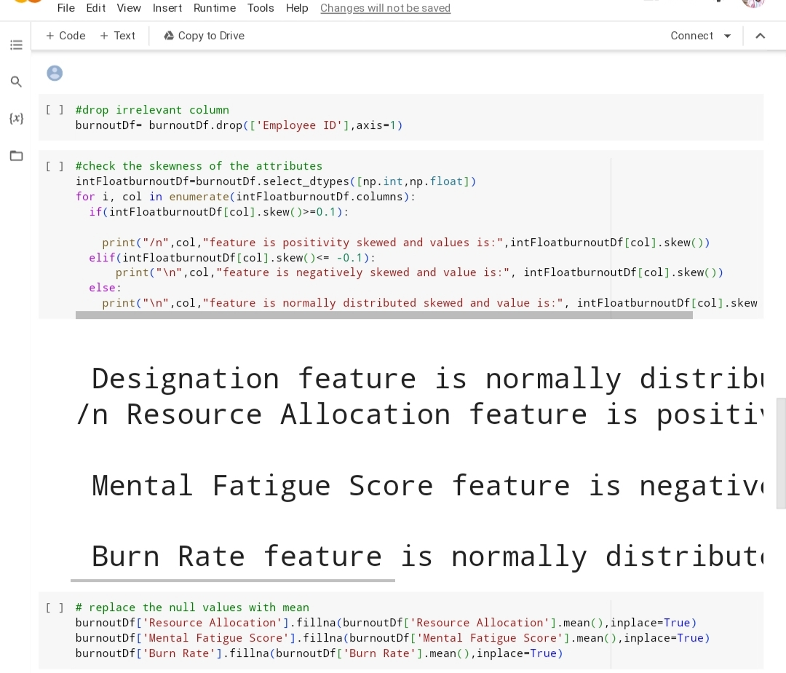

Slide 13
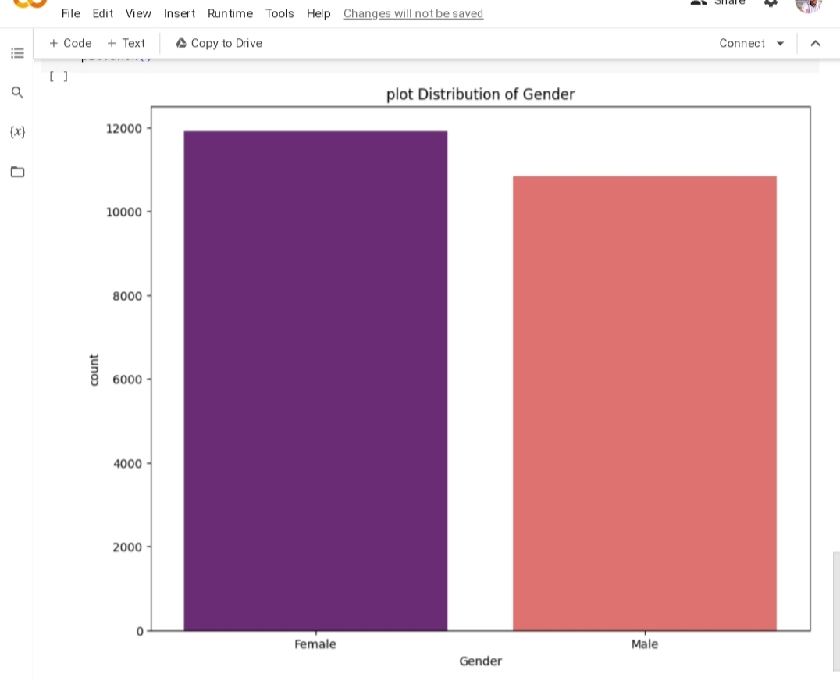
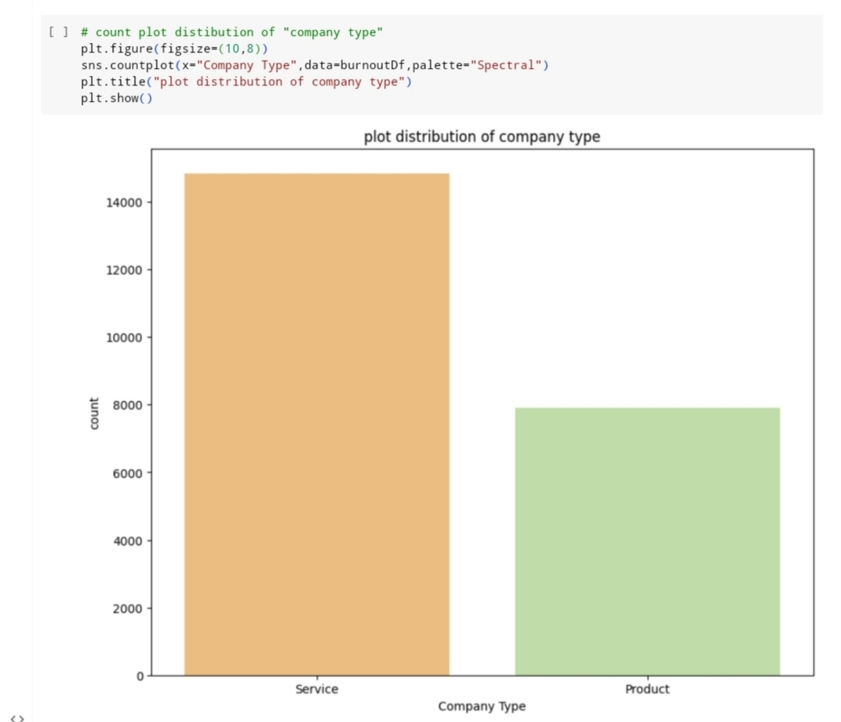

Slide 14
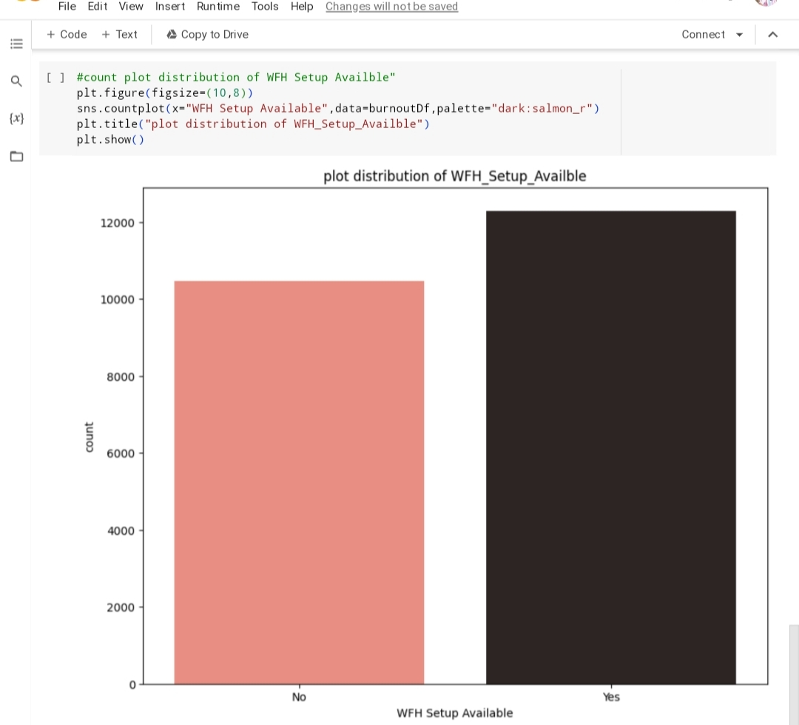

Slide 15
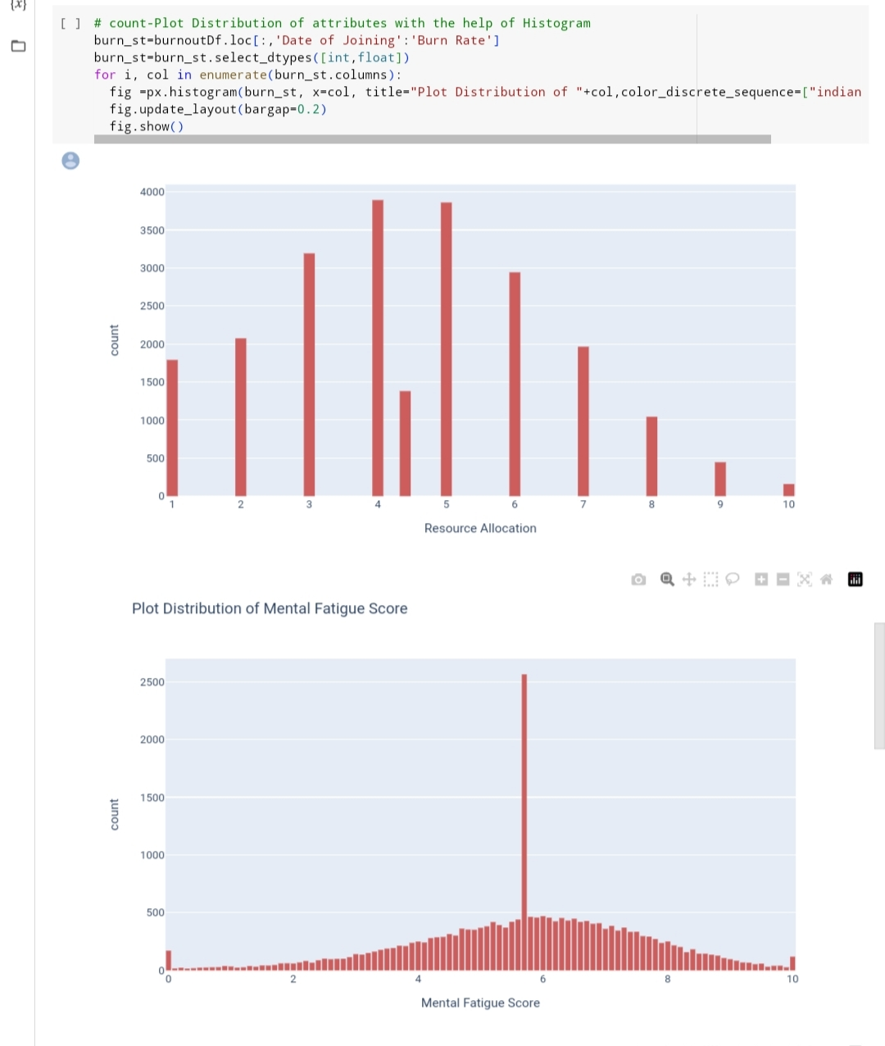
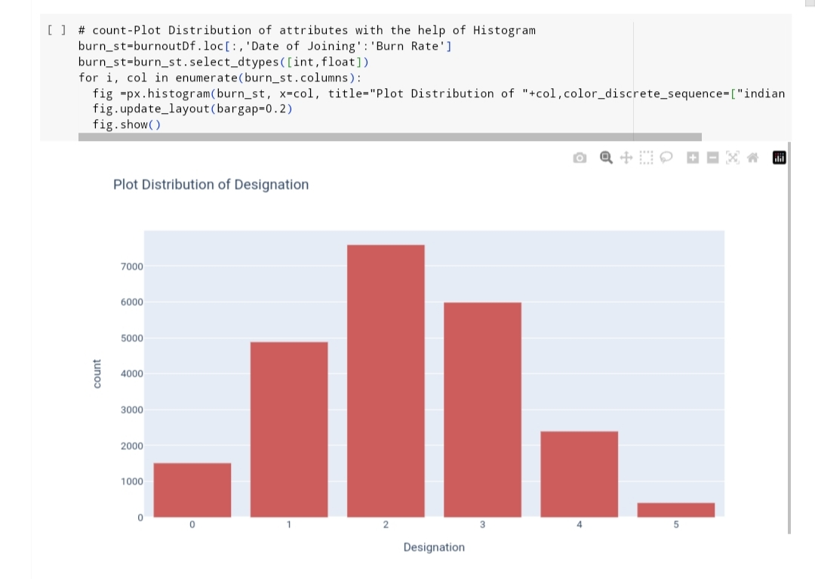

Slide 16
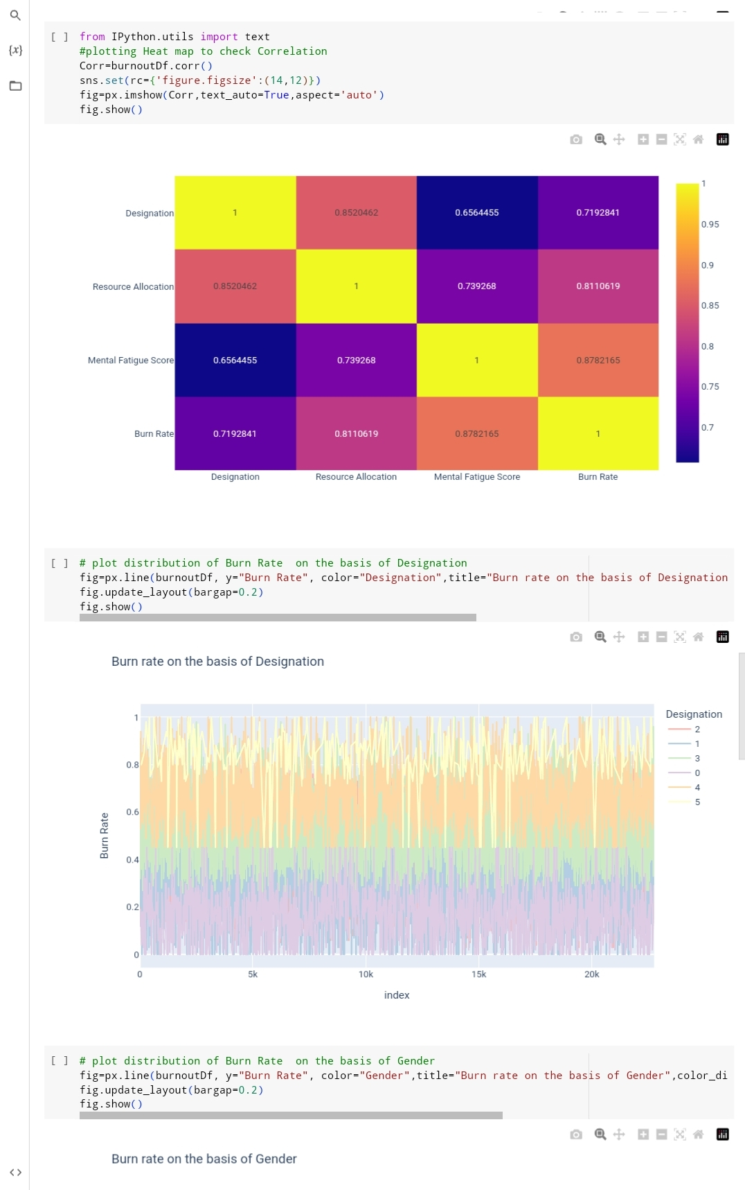
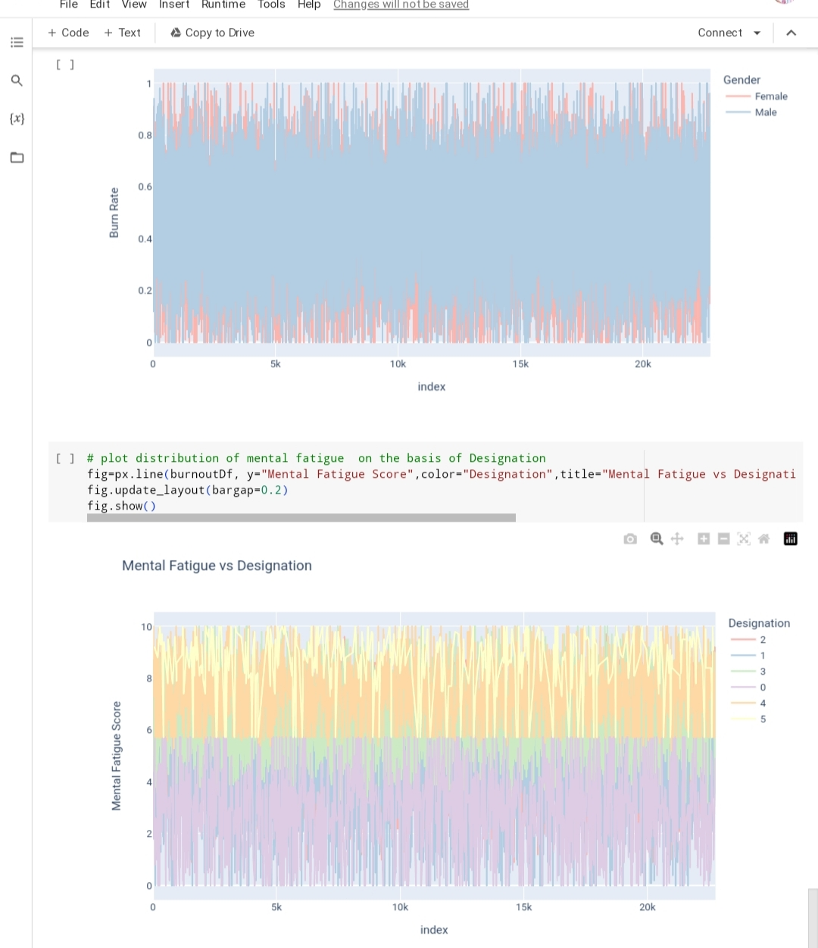
RESULT:-

Slide 17
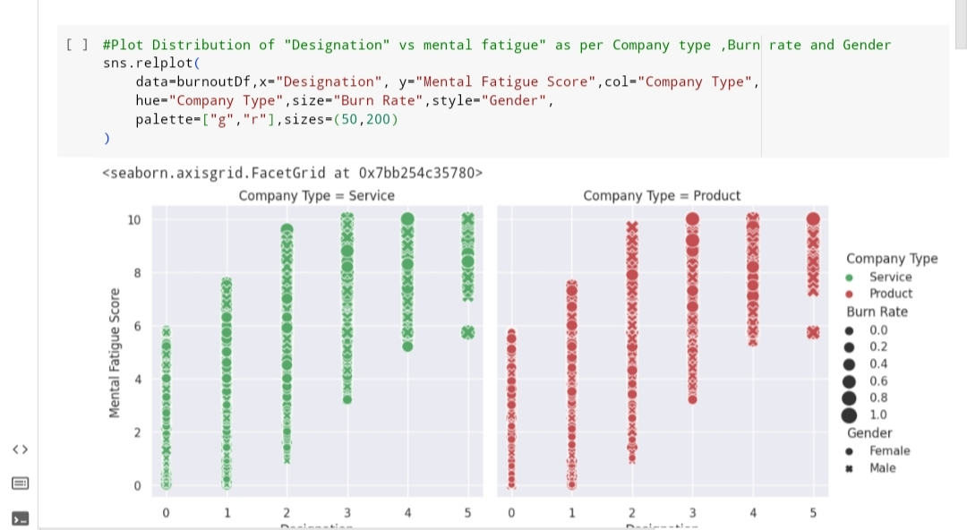
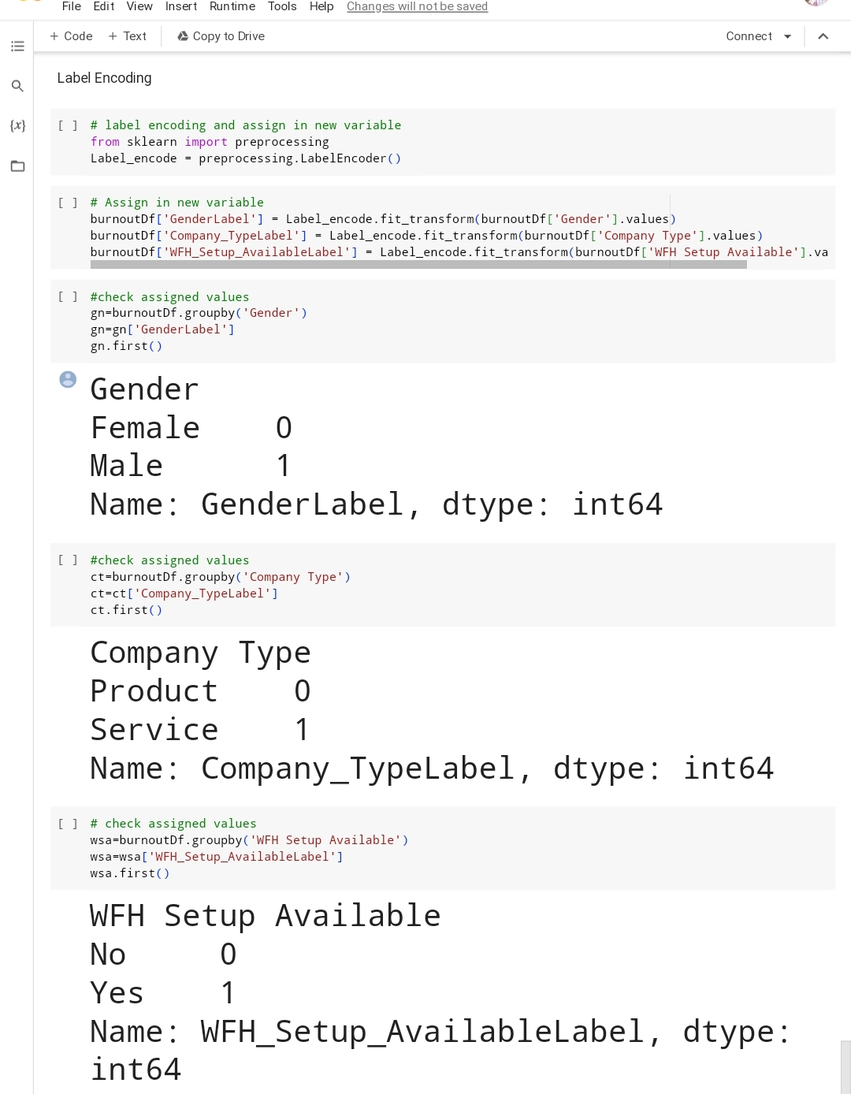

Slide 18
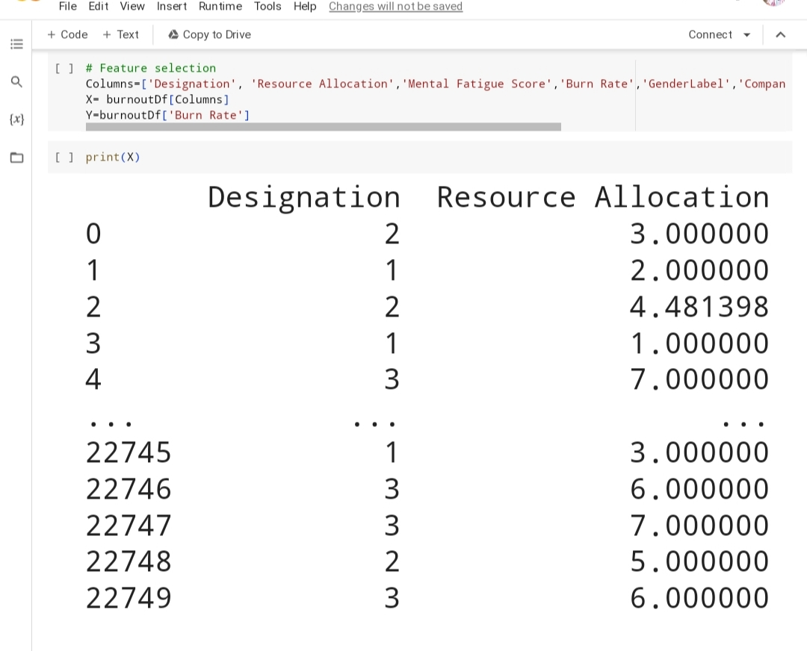
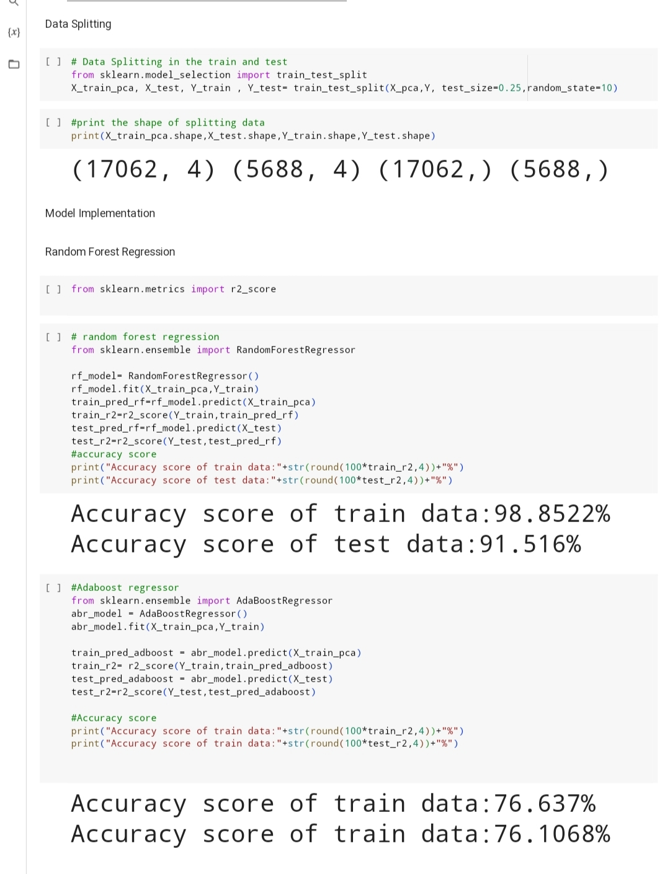

Slide 19
Links:-
https://github.com/Charvik143/Employees-Burnout-Analysis-and-Prediction.git
https://colab.research.google.com/drive/1kRyVuPdLBQ0n2h_PzTmfQDOWiBIQyjy3?usp=sharing

Slide 20


